Slide 1
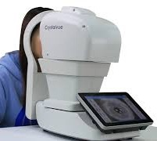
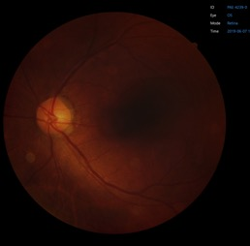
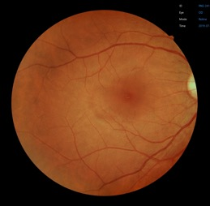
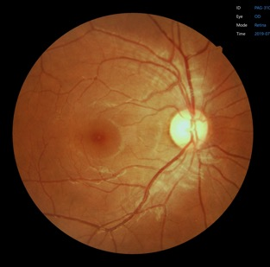
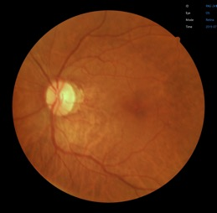
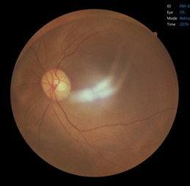
Retinal photo: quick guide
PRINT THIS PAGE AND DISPLAY AT EYE STATION
GOOD APPROACH
FAILED IMAGES
Too dark
Not aligned
Clean lens daily (lens cloth)
Correct chair/table height
Dark setting
Cloth over the head
Guide patient through procedure
GOOD IMAGE
Dilate pupils, repeat
Repeat
Blurred
Artefact
Good brightness
Sharp focus (vessels)
Good position (fovea + disc)
No artefacts
>90% images should be perfect
Repeat
Clean lens, repeat
IF IN DOUBT CHECK WITH TEAM MANAGER

Slide 2
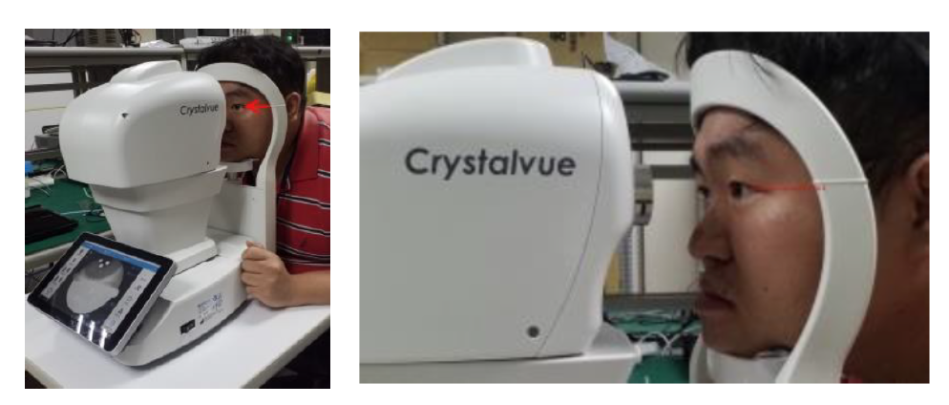
Retinal photo: correct seating height
Canthus mark
Adjust seating height of the participant such that participant can comfortably achieve the following:
Eyes in line with canthus mark
Forehead pressed firmly against forehead rest
Participant fully seated and comfortable on chair

Slide 3
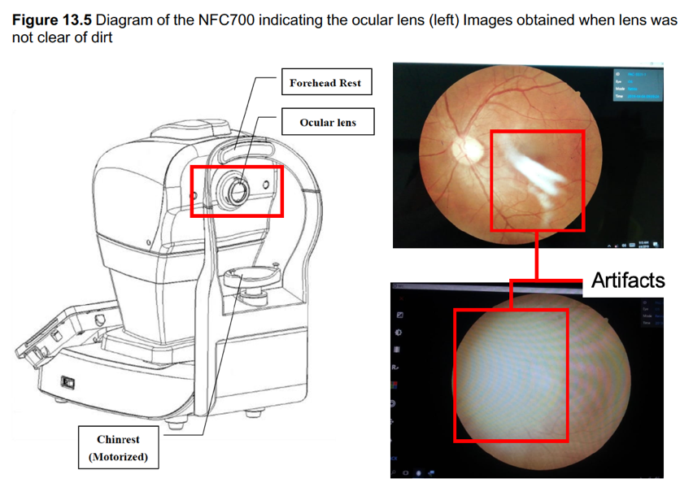
Retinal photo: cleaning instructions
Cleaning of lens
Obtain lens cleaning cloth or paper (e.g. UVEX Lens cleaning tissues or similar) and diluted Acetone or Lens cleaning solution
Wet the lens paper with cleaning solution and wipe the Ocular Lens with one pass in one direction. If using lens paper, discard the used lens paper
Use a new sheet for each repeat cleaning until the Ocular Lens is clean
Chinrest and forehead rest
Soak a cleaning cloth or towel in disinfecting solution or use a wet isopropyl alcohol cleaning paper pad
Wipe the chinrest and forehead rest with the cleaning towels or paper pad before or after use.
If the chinrest paper is used, remove one piece for each patient.

